Slide 1
Time-Step-Free Physics-based Modeling of 3-D NAND Flash Memories
Department of Electrical and Computer Engineering
Seoul National University
2026. 07. 08
석사과정
진 명

Slide 2
Content

Slide 3
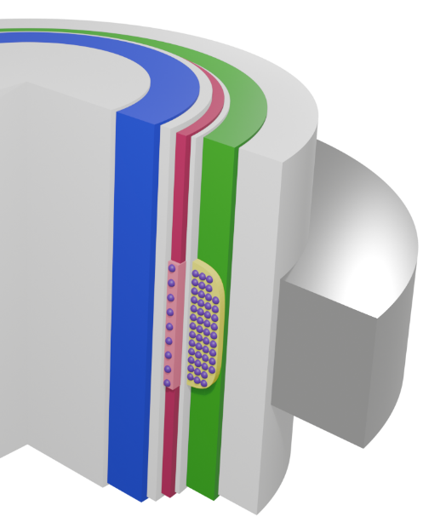
Trap-to-band Detrapping Mechanism
Bandgap-engineered tunneling oxide (BETOX)으로부터의 detrapping retention failure는 프로그램이 완료된 산포의 memory window를 감소시킴
Electron detrapping effect in ΔV_{th} distribution
Programmed Cells
channel
BETOX
…
CTN
Erased Cells
BOX
filler
gap margin (memory window)
degradation
WL
3-D NAND flash memory의 cylindrical 구조에서의 BETOX에서 channel으로 detrapping이 일어나는 현상에 대한 modeling 진행
Trapped Electrons
[1] Jin, TED 2025

Slide 4

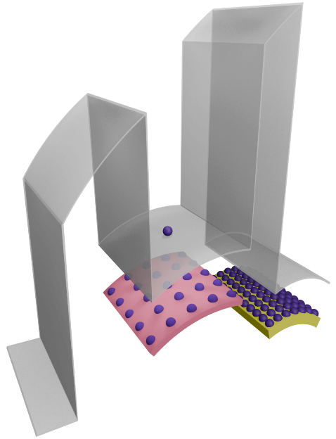


BETOX Trapped Electron Detrapping
Program (V_{G} = V_{pgm},)
Retention (V_{G} = 0 V)
BETOX
Program에서는 FN 터널링이 일어날 만큼 강한 전기장이 걸리지만, retention 상황에서는 direct 터널링 대신 trap-to-band 터널링이 주로 일어남
BETOX
o1
o1
n1
Si-Channel
e_{DT}
E_{F}
J_{FN}
e_{TBT}
E_{F}
n1
Si-Channel
BETOX Region
(ONO)
선행연구[조형준 TTT trap 측정]를 기반으로 보았을 때, BETOX내의 trap profile 측정자료에 의하면 detrapping의 주요 mechanism은 trap-to-band tunneling임
CTN
Region
Trap-to-Band Tunneling Emission
[1] Jin, TED 2025

Slide 5
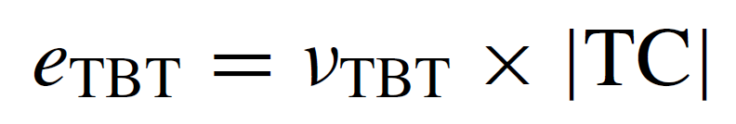
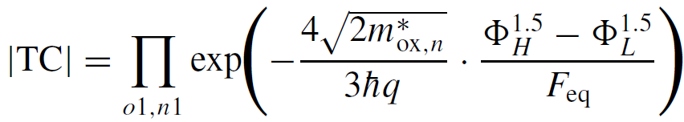
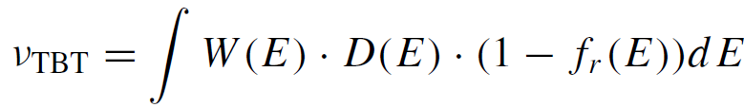
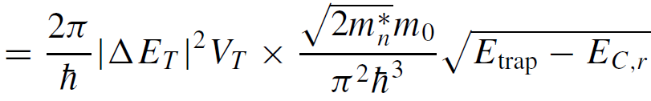
Trap-Band Emission Modeling
BETOX의 O/N/O/N/O 5-layer 구조 Poisson solution
Emission rate 모델링 결과식
[1] Jin, TED 2025

Slide 6
CTN Trapped Electron Detrapping
BETOX 내의 전자들의 Detrapping이 CTN에서도 동일하게 모델링 적용 가능
기존모델 (Amoroso, TED 2011) 문제점
CTN내 uniform distribution에 대해서만 모델링
Vth 계산식 최적화 과정이 없음
Trapped Electrons
[2] Jin, EDL 2026

Slide 7






Visualization of Charge Node Analysis
...
Q
=
ΔQ₀
ΔQ₁
ΔQ_{N}
+
+
+
...
=
...
+
+
+
r₀
r₁
r_{N}
CTN charge
ΔQ_{i} = πr_{i}²(n_{t,i+1}-n_{t,i})
n_{t,0} = 0
n_{t,N+1} = 0
where, i=1-N
$$C_{TOX}$$
$$C_{1}$$
$$C_{2}$$
$$C_{3}$$
$$C_{N}$$
$$C_{BOX}$$
ΔQ₀
ΔQ₁
ΔQ₂
ΔQ₃
ΔQ_{N-1}
ΔQ_{N}
[2] Jin, EDL 2026

Slide 8







Visualization of Charge Node Analysis
ex) Uniform distribution : ΔQ₀ = Q, ΔQ_{N} = -Q , else ΔQ_{i} = 0
$$C_{TOX}$$
$$C_{1}$$
$$C_{2}$$
$$C_{3}$$
$$C_{N}$$
$$C_{BOX}$$
$$…$$
ΔQ₀
ΔQ_{N}

Slide 9
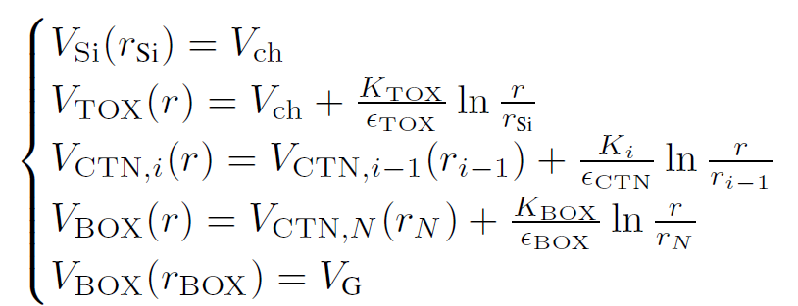
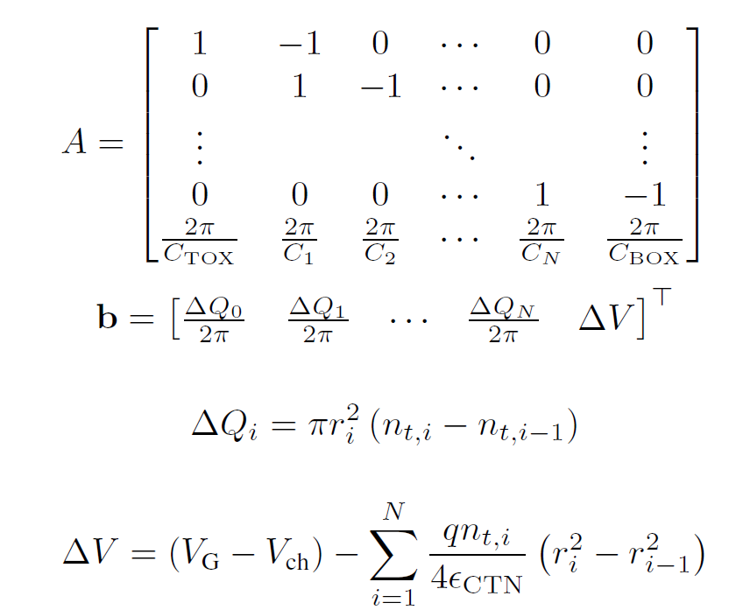


Detailed Poisson Solution
Potential Solution: Poisson equation
Boundary conditions
Solution
Then…
x = A⁻¹b ..?
Optimization!
[2] Jin, EDL 2026

Slide 10


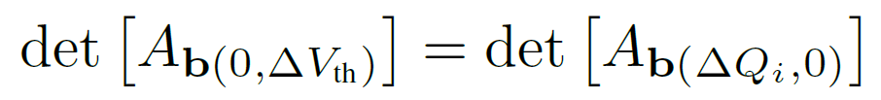
Q-ΔV_{th} Optimized Calculation
ΔV_{th} : Equivalent channel field intensity
By Cramer’s rule,
[2] Jin, EDL 2026

Slide 11
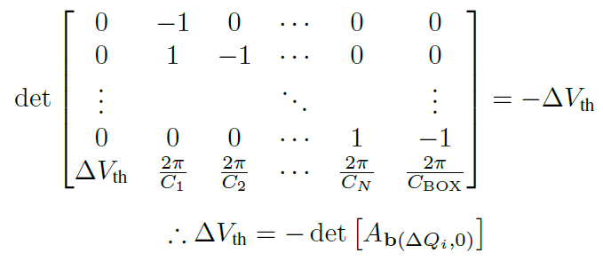
Q-ΔV_{th} Optimized Calculation
[2] Jin, EDL 2026

Slide 12
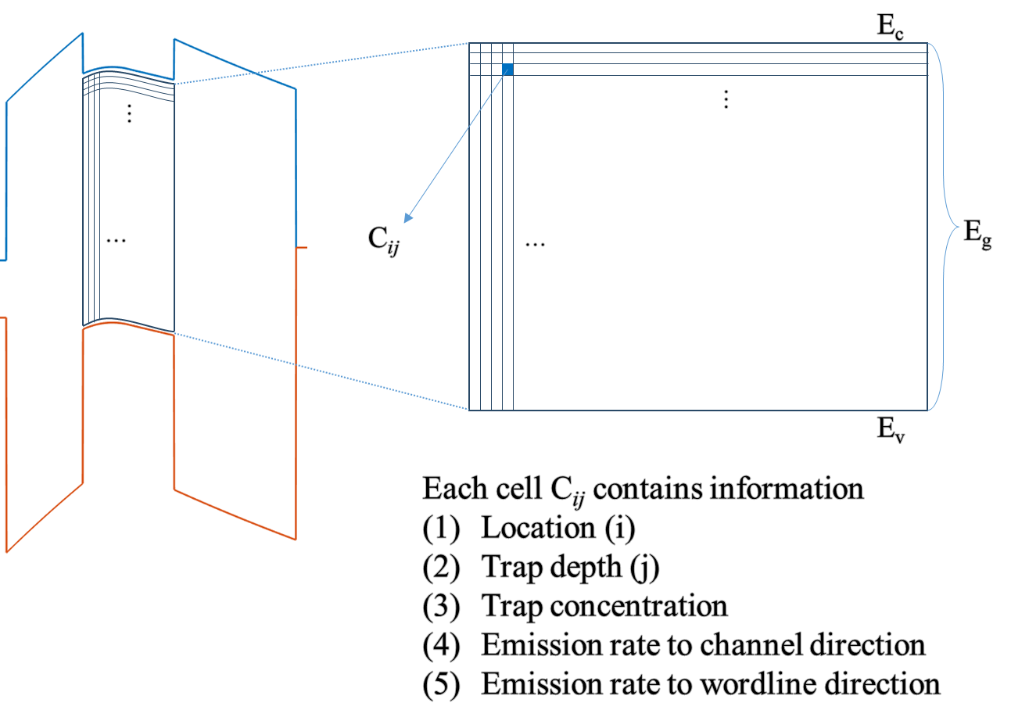
Time-step-free Physics-based Modeling
Main Idea: simulation done with initial condition
=> different from time stepping transient simulation
1. Initial state
n_{t0}(r, E_{t})
2. Emission rates
e_{ch}, e_{WL}
3. Direct evaluation
n_{t}(r, E_{t}, t)
계산 비용은 final retention time 자체가 아니라
trap bin 수와 evaluated time point 수에 의해 결정
[2] Jin, EDL 2026

Slide 13
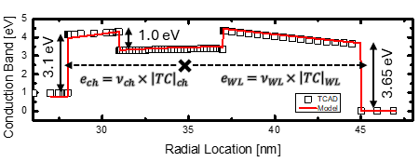
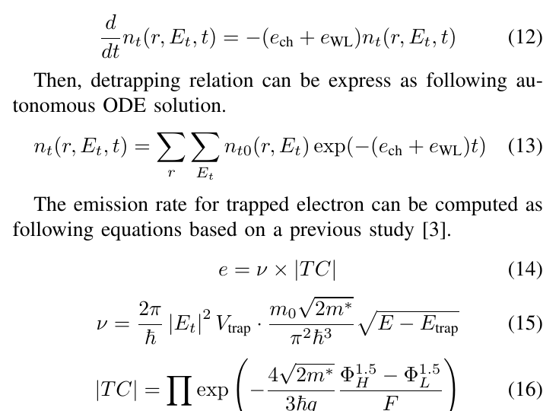
Time-step-free Physics-based Modeling
Main Idea: simulation done with initial condition
=> different from time stepping transient simulation
1. Initial state
n_{t0}(r, E_{t})
2. Emission rates
e_{ch}, e_{WL}
3. Direct evaluation
n_{t}(r, E_{t}, t)
[2] Jin, EDL 2026

Slide 14

Time-step-free Physics-based Modeling
Main Idea: simulation done with initial condition
=> different from time stepping transient simulation
1. Initial state
n_{t0}(r, E_{t})
: Autonomous ODE
Detrapping Autonomous ODE
2. Emission rates
e_{ch}, e_{WL}
3. Direct evaluation
n_{t}(r, E_{t}, t)
Initial state
closed-form evaluation
computation resource는 final retention time 자체가 아니라
trap bin 수와 evaluated time point 수에 의해 결정
[2] Jin, EDL 2026

Slide 15
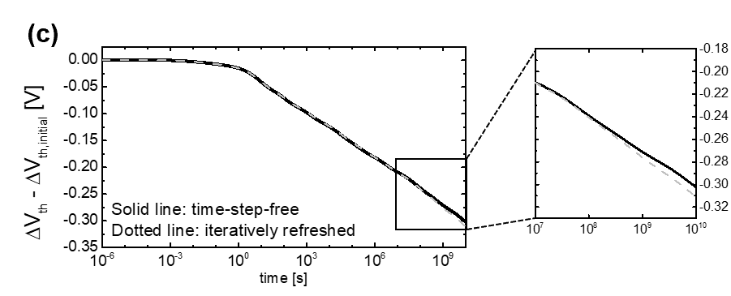
Iteration Test
[2] Jin, EDL 2026

Slide 16
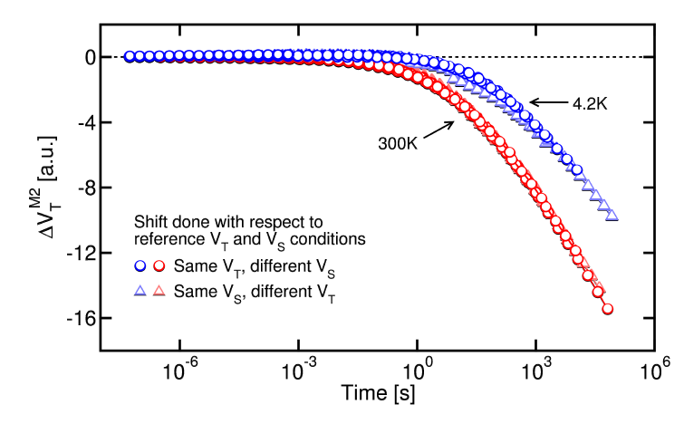
Cryogenic-like Emulation
Why cryogenic?
Measurement (Refaldi, IRPS 2025)
Cryogenic condition (~ 4.2K) : physical separation of detrapping effect from vertical retention loss
Separation of detrapping effect measurement
[2] Jin, EDL 2026

Slide 17
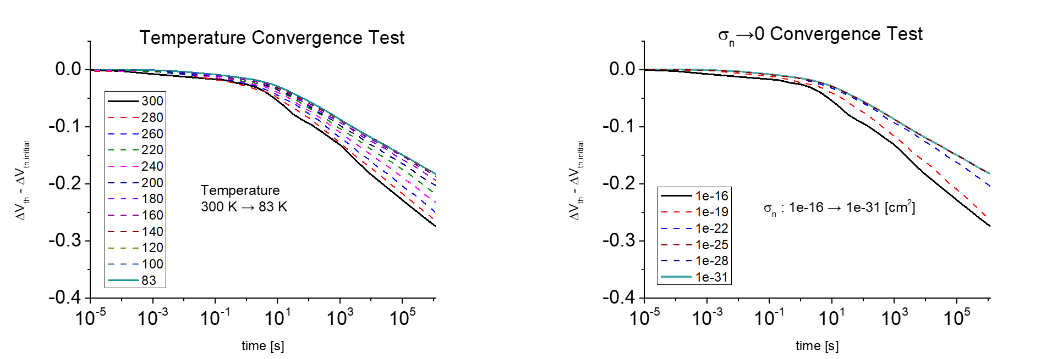
Cryogenic-like Emulation

Slide 18
Cryogenic-like Emulation
Measurement – TCAD calibration
model – TCAD match
TCAD cryogenic: σ → 0 [cm²]
O/N/O = 3/6/8
t_{TOX} = 3 ~ 5 [nm]
t_{TOX}
= 3, 3.5, 4, 4.5, 5 [nm]
[2] Jin, EDL 2026

Slide 19
Computational Impact
Property
Transient TCAD
Time-step-free model
Temporal
treatment
Sequential
time stepping
Closed-form
evaluation of Eq. (13)
Final-time
dependence
Runtime grows as
simulated retention time increases
Independent of final
physical time for fixed queries
Average
runtime
27483 s
3.926 s
≈ 7000×
runtime reduction
TCAD 는 final physical time까지 time step 별 순차적으로 계산
Time-step-free model은 closed-form evaluation
Computational resource는 final retention time 자체가 아니라 trap bin 수와 evaluated time point 수에 의해 결정
[2] Jin, EDL 2026

